Slide 1

as a new computing tool
Submitted by :
Anirban Saha (Roll No: CIS/17/02-002 )
Manu Gond (Roll No: CIS/17/02-013)
Sujash Naskar (Roll No: CIS/17/02-024)
Under guidance of :
Prof. Gautam Mahapatra
Prof. Suman mitra
Prof. Atrayee Chatterjee

Slide 2
Contents
Introduction to TensorFlow and its architecture
Neural Networks
Learning techniques of ANNs
Tensor
Data Flow Graphs
Tensorboard
Example of ANN using TensorFlow
Benefits and limitations of tensorflow
Conclusion
Reference

Slide 3
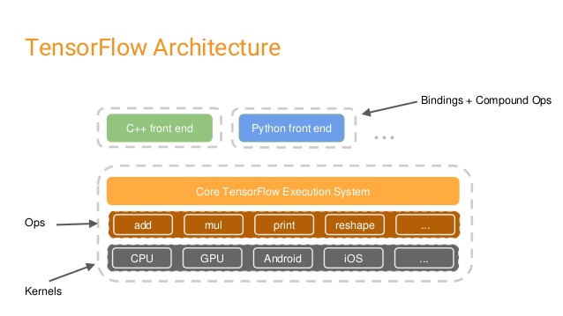
Introduction to tensorflow and architecture overview
Developed by the Google Brain Team, Tensorflow is an open source library for numerical computation using data flow graphs.
It provides primitives for defining functions on Tensors and automatically computing their derivatives.
High Level APIs(Java, Python, etc.)
Core Tensorflow Execution System (Low Level APIs)
Accelerators (GPUs, CPUs, TPUs)

Slide 4
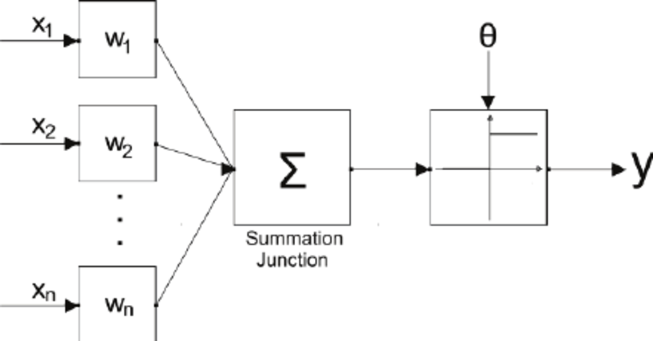


Neural networks
Basic Artificial Neuron:-
It contains,
Input units: ( X₁ , X₂ , ……..X_{n} . )
Weights per input unit: ( w₁ ,w₂ , ………w_{n .} )
Input signals : (x₁ , x₂ , ……..x_{n} ).
Input to output unit (y):
$y_{in}=\sum_{i=1}^{n}{\text{( }\text{xi}\text{ ∗ }\text{wi}}$ )
Threshold ( ) which is used with a selected activation function to fire off the output.
$$θ$$

Slide 5
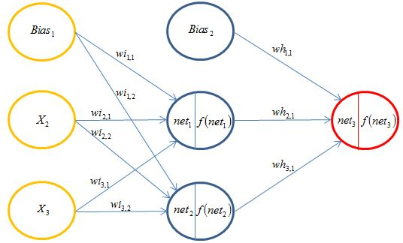
Neural Networks
Artificial Neural Network:- ANN consists of a number of artificial neurons connected among themselves in certain ways. These can be arranged in layers with interconnection between them.
Types of ANNs:
➔ Single Layer Feed Forward.
Multilayer Feed Forward.
Competitive Network
Recurrent Network

Slide 6
LEARNING TECHNIQUES OF ANN
Machine Learning is a part of Artificial Intelligence.
Machine Learning is some sort of statistical tools and algorithm that are used to learn from data. It is used to make machines capable of doing tasks like human intelligence.
Like a nastic human being , a machine learning model learns from data samples (predictor variable) as in training phase; and then it finally concludes with predicting some answers (target).
The main types of Machine Learning are :
Supervised Machine Learning.
Unsupervised Machine Learning.
Reinforcement Machine Learning.

Slide 7
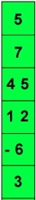
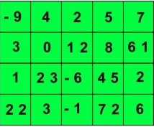
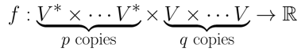
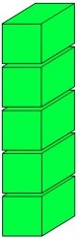
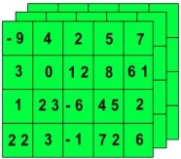
tensor
Formally, Tensors are multilinear maps from vector spaces to the real numbers (V vector space, and V* dual space).
A scalar is a tensor.
A vector is a tensor.
A matrix is a tensor.
Common to have fixed basis, so a tensor can be represented as a multidimensional array of numbers.
2D tensor
1 D tensor
3D Tensor
4D tensor

Slide 8

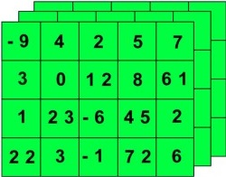
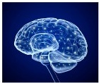
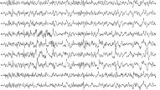
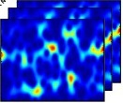
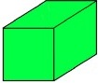
TENSOR
3D Tensor
Examples:-
➔ A RGB Image has :-
(width, height, color_depth )
Time series data like Brain’s EEG scan has three values
(time, frequency, channel)
RGB Image
Channel
Brain
EEG
3D Tensor
Frequency
Time

Slide 9
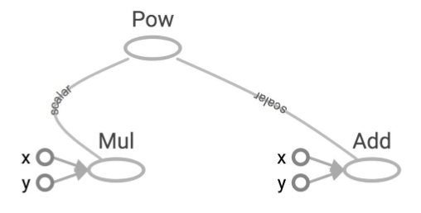
Data flow graphs
In a dataflow graph computations are represented as graphs where:
● Nodes are the operations.
● Edges are the Tensors.
It offers following :-
Parallelism
Distributed execution
Compilation
Portability

Slide 10
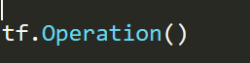
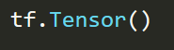
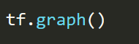
Creating a data flow graph in tensorflow
Programs start with graph construction phase. Invoking Tensorflow API constructs the data flow graph.
This will create a new object(or maybe overwrite an existing object) and add a node in a graph.
This will create a new object add edge in a graph.
This will be used for finally writing graph as file with help of File Writer (to be used to store it and make it available for later use by importing it in another language like C++.
By default the graph is created when we run the session and can be visualized with TensorBoard.

Slide 11

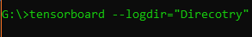
TensorBoard
TensorBoard provides a suite of visualization tools to make it easier to understand, debug, and optimize programs.
We can use it to visualize your TensorFlow graph, plot quantitative metrics about the execution of our graph.
To write the summary of a tensorflow session we need to use:-
To launch tensorboard:

Slide 12
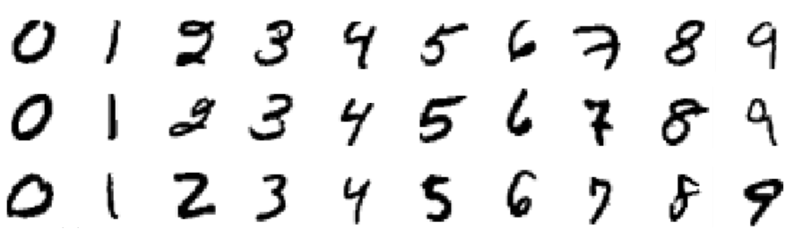
ANN for Predicting a handwritten digit
Training data set will contain 28x28 size handwritten images of digits of total 55,000 images.
ANN will contain 3 hidden layers of 512, 256, 128 neurons each.
Input will contain 784 neurons since we are using 28x28 sized image, hence in total we have 1690 neurons here in this ANN.
Output will contain 10 neurons to represent [0-9]
When reading the labels we will use one-hot-encoding for
actual digits.
Hence here the vector=[0, 0, 0, 0, 1, 0, 0, 0, 0, 0] will represent 4
Fig: Example of our image data set

Slide 13
ANN for Predicting a handwritten digit
Steps:
Propagate values forward to network
Compute the loss
Propagate values backwards
Update the parameters
1
1
1
1
Output
2
2
2
2
1
.
.
.
.
.
.
.
.
.
.
.
.
.
.
.
.
.
.
2
Input
Layer
.
.
10
512
256
128
784
After every 100 iterations we will feed a mini batch of images to compute the accuracy
Fig: 784 x 512 x 256 x 128 x 10 Neural Network with 3 hidden layers

Slide 14
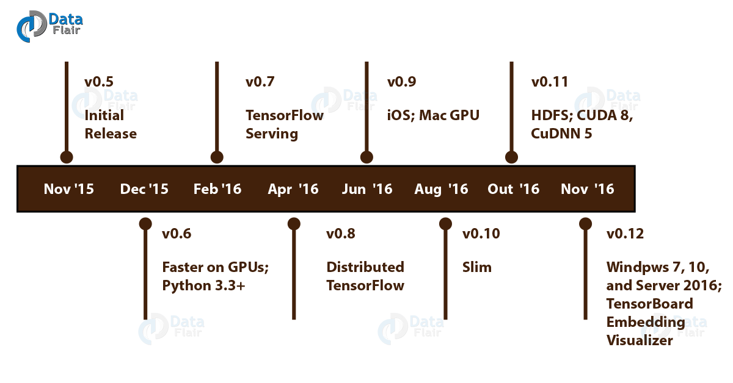
Benefits and limitations of tensorflow
We have to know the advantages and disadvantages of tensorflow which will guide us to understand its benefits and limitations.
Advantages :-
Graphs
Library Management
Debugging
Scalability
Pipelining
TensorFlow serving API

Slide 15
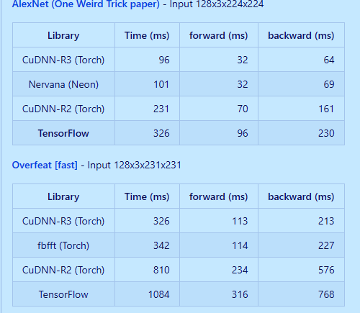
Benefits and limitations of tensorflow
Disadvantages :-
Missing Symbolic Loops
Benchmark Tests
No GPU support other than Nvidia
And only full language support is for Python
Fig: benchmark tests on a 128 x 3 x 224 x 224 ANN

Slide 16
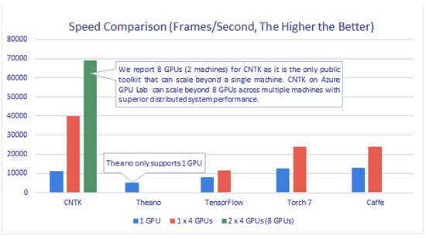
Speed test
Computation Speed:
This is the field where tensorflow is lagging behind but we should focus on the production
environment rather than the performance ,it is still good choice.

Slide 17
Conclusion
Hence it is an introduction to TensorFlow as a new computing tool, here we discuss what
is Tensorflow , how it works and also history and features of Tensorflow. Along with this we
discussed Tensorflow examples, its advantages, disadvantages. Moreover we also learned
about Tensors and Tensorboards.
However there is a lot research work going on currently on Tensorflow as a computing
Technique and day by day it is becoming better.

Slide 18
References
Dean, Jeff, and Rajat Monga, "TensorFlow: Large-scale machine learning on heterogeneous systems." TensorFlow. org. Google Research. Retrieved 10 (2015).
Kevin P. Murphy, “Machine Learning: A Probabilistic Perspective”, MIT Press, ISBN 0262018020, 9780262018029
D. Graupe, "Principles of Artificial Neural Networks.3rd Edition", World Scientific Publishers, ISBN-13: 978-9814522731 , ISBN-10: 9814522732
Tensorflow Official API Guide : https://www.tensorflow.org/guide/
About Data Flow Graph : https://www.threadingbuildingblocks.org/docs/help/tbb_userguide/Data_Flow_Graph.html
About Tensorboard : https://learningtensorflow.com/Visualisation/
About Cloud TPU : https://www.bmc.com/blogs/google-cloud-tpu/

